Slide 1
Recursion II

Slide 2
Recursion
Great fun in visual art. Known as the Droste effect.
Also possible in software. Provides elegant solutions, but generally not so good for your computer.

Slide 3
Recursively Finding the Largest Element in a List
mymax(values)
input: a non-empty list of numbers
returns: the largest element in the list
examples:
>>> mymax([5, 8, 10, 2])
10
>>> mymax([30, 2, 18])
30

Slide 4
Design Questions for mymax()
When can I determine the largest element in a list without needing to look at a smaller list?
How could I use the largest element in a smaller list to determine the largest element in the entire list?
list1 = [30, 2, 18] list2 = [5, 12, 25, 2]
(base case)
(recursive case)
largest element = 18
mymax(list1) → ??
largest element = 10
mymax(list2) → ??

Slide 5
Design Questions for mymax()
When can I determine the largest element in a list without needing to look at a smaller list?
How could I use the largest element in a smaller list to determine the largest element in the entire list?
list1 = [30, 2, 18] list2 = [5, 12, 25, 2]
1. compare the first element to largest element in the rest of the list
2. return the larger of the two
Let the recursive call handle the rest of the list!
(base case)
when there's only one element
(recursive case)
largest element = 18
mymax(list1) → 30
largest element = 10
mymax(list2) → 10

Slide 6
Recursively Finding the Largest Element in a List
def mymax(values):
""" returns the largest element in a list
input: values is a *non-empty* list
"""
if len(values) == 1: # base case
return values[0]
else: # recursive case max_in_rest = mymax(values[1:])
if values[0] > max_in_rest:
return values[0]
else:
return max_in_rest

Slide 7
How many times will mymax() be called?
def mymax(values):
if len(values) == 1: # base case
return values[0]
else: # recursive case max_in_rest = mymax(values[1:])
if values[0] > max_in_rest:
return values[0]
else:
return max_in_rest
print(mymax([5, 30, 10, 8]))
1
3
4
5
6
Notes:
http://www.pythontutor.com/visualize.html#code=def%20mymax%28values%29%3A%0A%20%20%20%20if%20len%28values%29%20%3D%3D%201%3A%20%20%20%20%20%20%20%23%20base%20case%0A%20%20%20%20%20%20%20%20return%20values%5B0%5D%0A%20%20%20%20else%3A%20%20%20%20%20%20%20%20%20%20%20%20%20%20%20%20%20%20%20%20%20%20%23%20recursive%20case%20%20%20%20%20%20%0A%20%20%20%20%20%20%20%20max_in_rest%20%3D%20mymax%28values%5B1%3A%5D%29%0A%20%20%20%20%20%20%20%20if%20values%5B0%5D%20%3E%20max_in_rest%3A%0A%20%20%20%20%20%20%20%20%20%20%20%20return%20values%5B0%5D%0A%20%20%20%20%20%20%20%20else%3A%0A%20%20%20%20%20%20%20%20%20%20%20%20return%20max_in_rest%0A%0Aprint%28mymax%28%5B5,%2030,%2010,%208%5D%29%29%0A&cumulative=false&curInstr=14&heapPrimitives=nevernest&mode=display&origin=opt-frontend.js&py=3&rawInputLstJSON=%5B%5D&textReferences=false

Slide 8
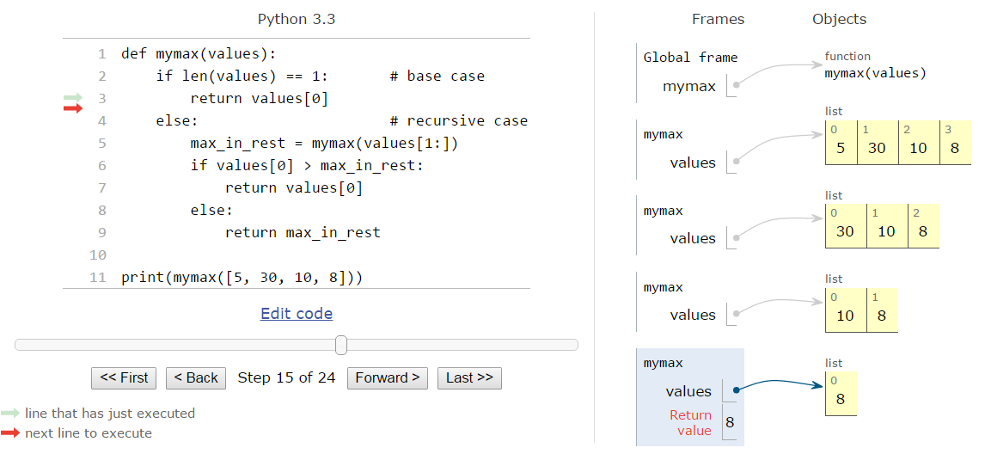
Visualizing Recursion (pythontutor.com/visualize.html)
Notes:
http://www.pythontutor.com/visualize.html#code=def%20mymax%28values%29%3A%0A%20%20%20%20if%20len%28values%29%20%3D%3D%201%3A%20%20%20%20%20%20%20%23%20base%20case%0A%20%20%20%20%20%20%20%20return%20values%5B0%5D%0A%20%20%20%20else%3A%20%20%20%20%20%20%20%20%20%20%20%20%20%20%20%20%20%20%20%20%20%20%23%20recursive%20case%20%20%20%20%20%20%0A%20%20%20%20%20%20%20%20max_in_rest%20%3D%20mymax%28values%5B1%3A%5D%29%0A%20%20%20%20%20%20%20%20if%20values%5B0%5D%20%3E%20max_in_rest%3A%0A%20%20%20%20%20%20%20%20%20%20%20%20return%20values%5B0%5D%0A%20%20%20%20%20%20%20%20else%3A%0A%20%20%20%20%20%20%20%20%20%20%20%20return%20max_in_rest%0A%0Aprint%28mymax%28%5B5,%2030,%2010,%208%5D%29%29%0A&cumulative=false&curInstr=14&heapPrimitives=nevernest&mode=display&origin=opt-frontend.js&py=3&rawInputLstJSON=%5B%5D&textReferences=false

Slide 9
How many times will mymax() be called?
def mymax(values):
if len(values) == 1: # base case
return values[0]
else: # recursive case max_in_rest = mymax(values[1:])
if values[0] > max_in_rest:
return values[0]
else:
return max_in_rest
print(mymax([5, 30, 10, 8]))
1
3
4
5
6

Slide 10
def mymax(values):
if len(values) == 1:
return values[0]
else:
max_in_rest = mymax(values[1:])
if values[0] > max_in_rest:
return values[0]
else:
return max_in_rest
How recursion
works...
mymax([0,1,2,3])
mymax([1,2,3])
mymax([2,3])
mymax([3])
number of calls for a list of length 4 = 4
number of calls for a list of length n = n
← grows reasonably.
double the number elements => twice as many calls, linear growth
Notes:
illustrate the difference:
first run mymax(range(20)) vs. mymax2(range(20)) -- just a slight lag for mymax2
then run mymax(range(30) vs. mymax2(range(30)) -- mymax2 hangs! (took about 14 minutes...)
you can also time the calls:
>>> import timeit
>>> timeit.timeit('mymax2(range(30))', setup='from __main__ import mymax2', number=1)

Slide 11
What's wrong (if anything) with this alternative?
def mymax(values):
""" returns the largest element in a list
input: values is a *non-empty* list
"""
if len(values) == 1:
return values[0]
else: # max_in_rest = mymax(values[1:])
if values[0] > mymax(values[1:]):
return values[0]
else:
return mymax(values[1:])

Slide 12
def mymax(values):
if len(values) == 1:
return values[0]
else: max_in_rest = mymax(values[1:])
if values[0] > max_in_rest:
return values[0]
else:
return max_in_rest
?
def mymax(values):
if len(values) == 1:
return values[0]
else: if values[0] > mymax(values[1:]):
return values[0]
else:
return mymax(values[1:])

Slide 13
def mymax(values):
if len(values) == 1:
return values[0]
else: max_in_rest = mymax(values[1:])
if values[0] > max_in_rest:
return values[0]
else:
return max_in_rest
def mymax(values):
if len(values) == 1:
return values[0]
else: if values[0] > mymax(values[1:]):
return values[0]
else:
return mymax(values[1:])
Quiz:
Does this function produce the same results as the alternative?
Always
Sometimes
I don’t know

Slide 14
def mymax(values):
if len(values) == 1:
return values[0]
else: max_in_rest = mymax(values[1:])
if values[0] > max_in_rest:
return values[0]
else:
return max_in_rest
def mymax(values):
if len(values) == 1:
return values[0]
else: if values[0] > mymax(values[1:]):
return values[0]
else:
return mymax(values[1:])
Quiz:
Is the alternative function as efficient?
Always
Sometimes
I don’t know

Slide 15
What's wrong (if anything) with this alternative?
def mymax(values):
""" returns the largest element in a list
input: values is a *non-empty* list
"""
if len(values) == 1:
return values[0]
else: # max_in_rest = mymax(values[1:])
if values[0] > mymax(values[1:]):
return values[0]
else:
return mymax(values[1:])
Hint: Try and come up with a worst case input

Slide 16
def mymax(values):
if len(values) == 1:
return values[0]
else: max_in_rest = mymax(values[1:])
if values[0] > max_in_rest:
return values[0]
else:
return max_in_rest
def mymax(values):
if len(values) == 1:
return values[0]
else: if values[0] > mymax(values[1:]):
return values[0]
else:
return mymax(values[1:])
Clicker Quiz:
Is the alternative function as efficient?
Always
Sometimes – Consider mymax([0,1,2,3]), [0,1,2,3] is an example worst case input
I don’t know

Slide 17
def mymax(values):
if len(values) == 1:
return values[0]
else: if values[0] > mymax(values[1:]):
return values[0]
else:
return mymax(values[1:])
How recursion
works...
mymax([0,1,2,3])
mymax([1,2,3])
mymax([1,2,3])
mymax([2,3])
mymax([2,3])
mymax([2,3])
mymax([2,3])
mymax([3])
mymax([3])
mymax([3])
mymax([3])
mymax([3])
mymax([3])
mymax([3])
mymax([3])
number of calls for a list of length 4 = 15
number of calls for a list of length n =
2^{n} – 1 ← gets big fast!!!
increase length by one => twice as many calls, exponential growth
Notes:
illustrate the difference:
first run mymax(range(20)) vs. mymax2(range(20)) -- just a slight lag for mymax2
then run mymax(range(30) vs. mymax2(range(30)) -- mymax2 hangs! (took about 14 minutes...)
you can also time the calls:
>>> import timeit
>>> timeit.timeit('mymax2(range(30))', setup='from __main__ import mymax2', number=1)

Slide 18
Efficient solutions are desirable
Here the first solution made a linear number of calls for an input of length (n), whereas the second made an exponential number calls to itself for an input of length (n)
Last week we created a fac function using n=n(n-1)! As the recursive step,
b^n can be defined similarly, i.e.,
b^n = b(b^(n-1))
as it’s recursive step. Here’s an alternate approach.
b^n = [b^(n/2)]^2, if n even
b^n = b*b^(n-1), if n odd
Breakout: Code each, which one is more efficient? Why?

